Slide 1
Assured Contract Farming System for Stable Market Access
Date of submission
07 December, 2024

Slide 2
Introduction
Problem Statement:
Farmers face market uncertainties and fluctuating prices.
Buyers need a reliable platform to procure agricultural products.
Solution:
Develop a platform to facilitate contract farming by connecting farmers and buyers.

Slide 3
Objectives
Provide farmers with stable market access.
Enable buyers to procure quality produce securely.
Ensure transparency in payments and contract management.
Deliver market insights to farmers for better decision-making.

Slide 4
Project Scope
Modules:
User Management (Farmers and Buyers).
Contract Management (Creation, Negotiation, Signing).
Payment Processing (Secure and Escrow Payments).
Market Insights (Analytics and Pricing Trends).
Notifications and Messaging.
Assured Contract Farming System for Stable Market Access

Slide 5
System Architecture
Diagram showcasing:
Client (Browser) → Presentation Layer (HTML/CSS/JS).
Application Layer (JSP, Servlets) → Business Logic.
Database Layer (MySQL) → Data Storage.
Mention MVC architecture for modularity.

Slide 6
Key Features
For Farmers:
List crops with quantity, price, and location.
Accept or reject purchase requests.
For Buyers:
Browse crops and create contracts.
View purchased contracts and make payments.
For Admin:
Monitor system activities and manage users.

Slide 7
Implementation Details
Technologies Used:
Frontend: HTML, CSS, JavaScript.
Backend: JSP, Java Servlets.
Database: MySQL.
Tools: VS Code, Apache Tomcat.
Key Functionalities:
Registration and Login.
Dashboards for Farmers and Buyers.
Payment Gateway Integration.

Slide 8
Database Design
Include an ER Diagram with entities:
Users, Contracts, Payments, Market Data.
Highlight key tables and relationships:
Users → Contracts → Payments.

Slide 9
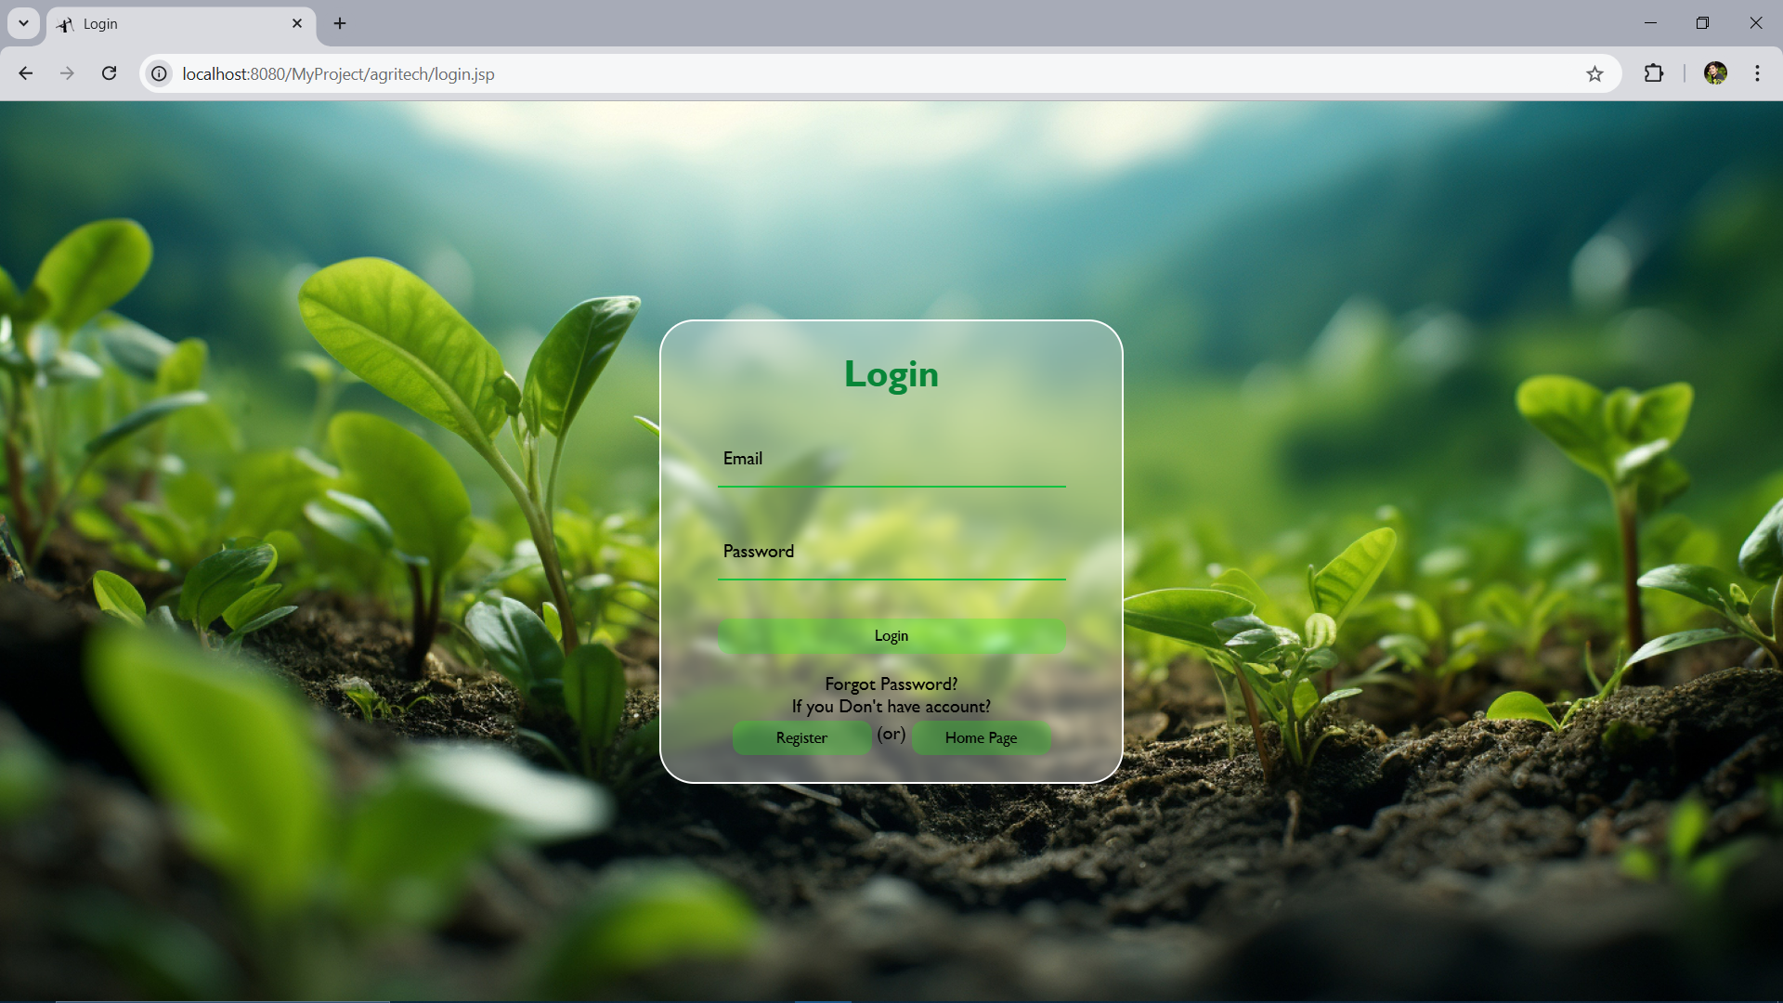
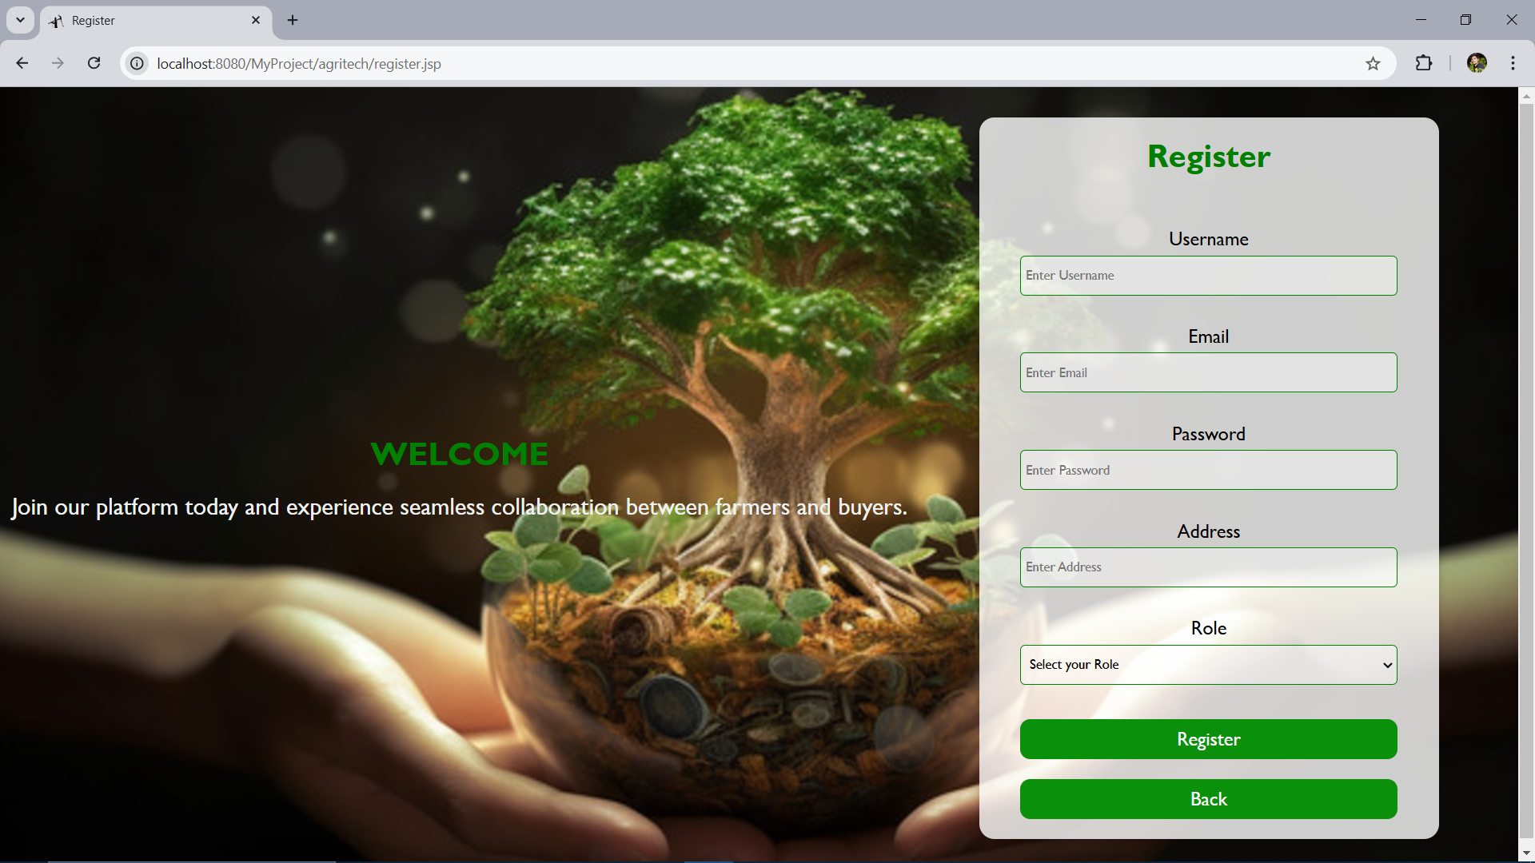
User Interface
Login and Registration Pages.

Slide 10
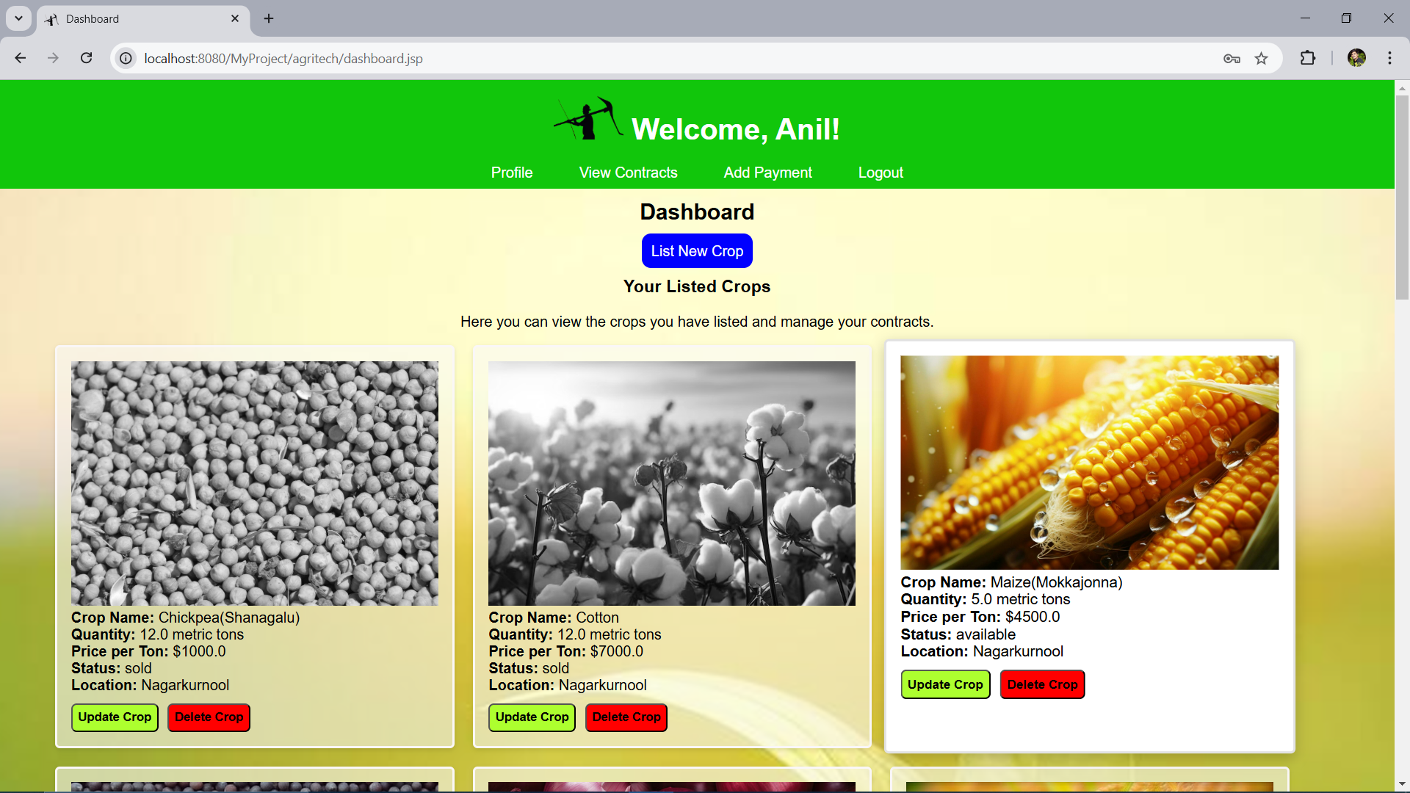
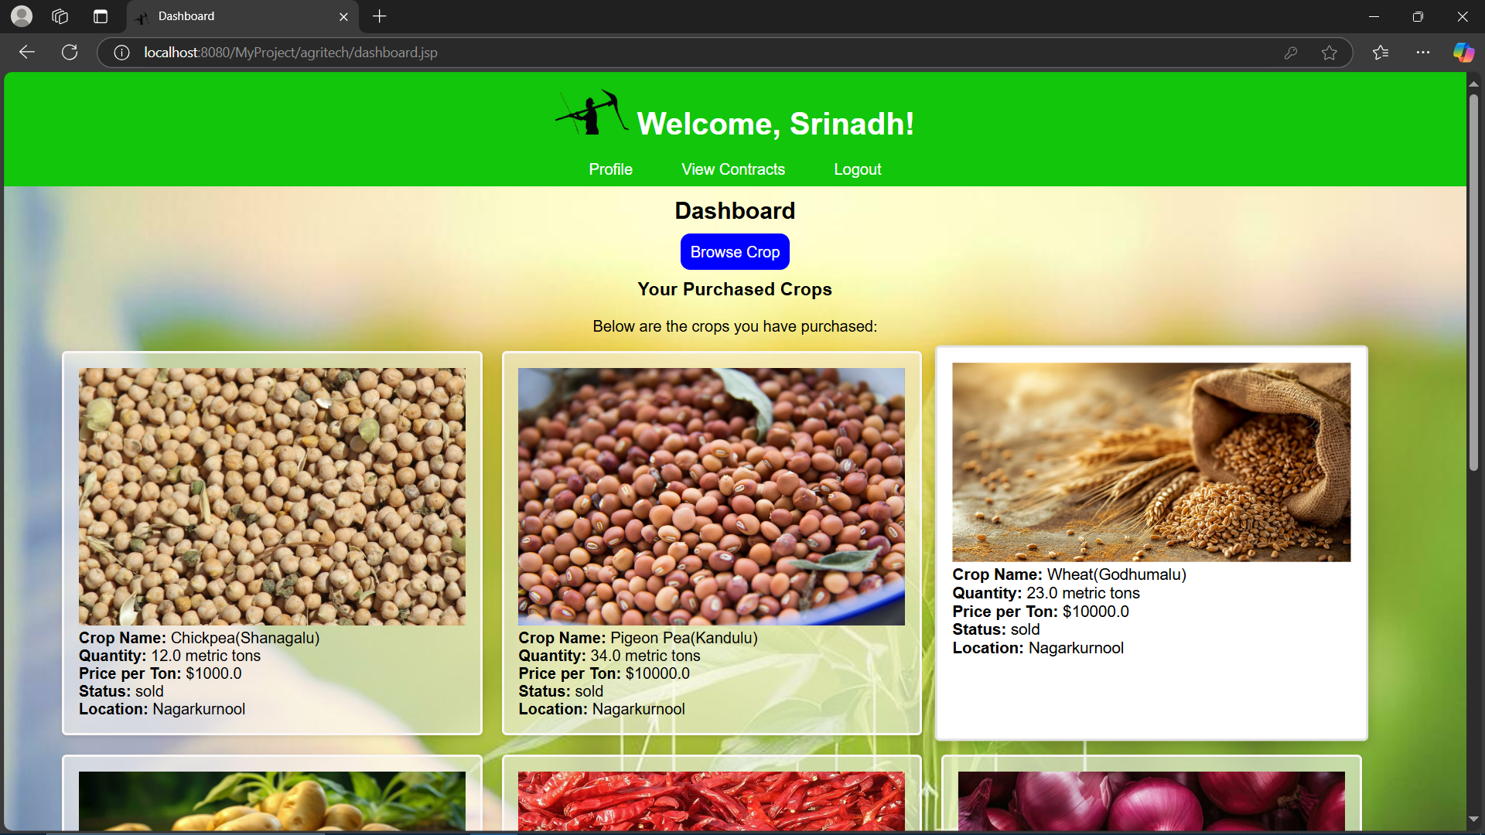
User Interface
Farmer's Dashboard.
Buyer's Dashboard.

Slide 11
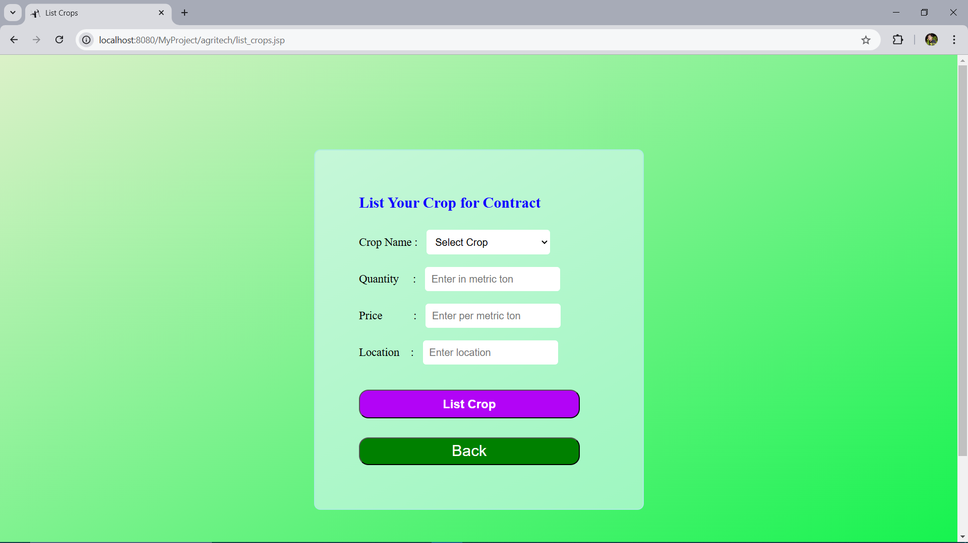
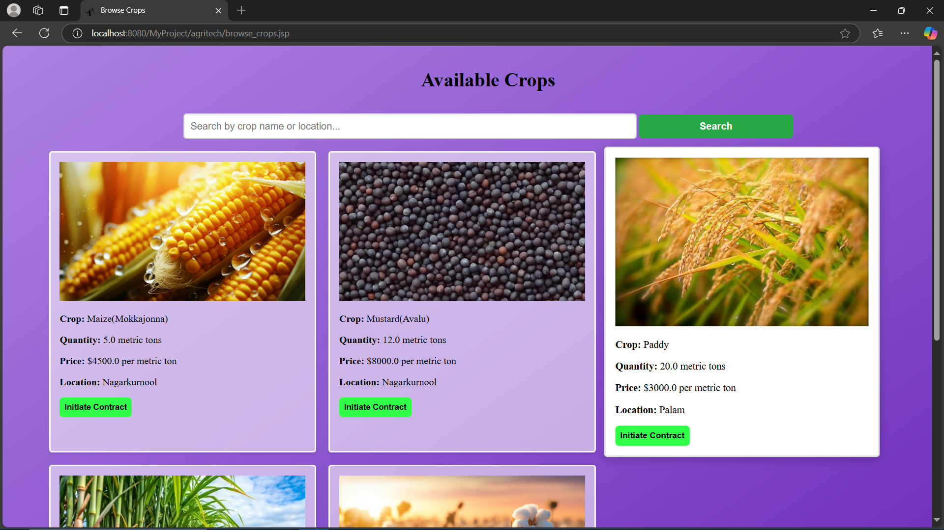
User Interface
Listing Crops
Browse Crops

Slide 12
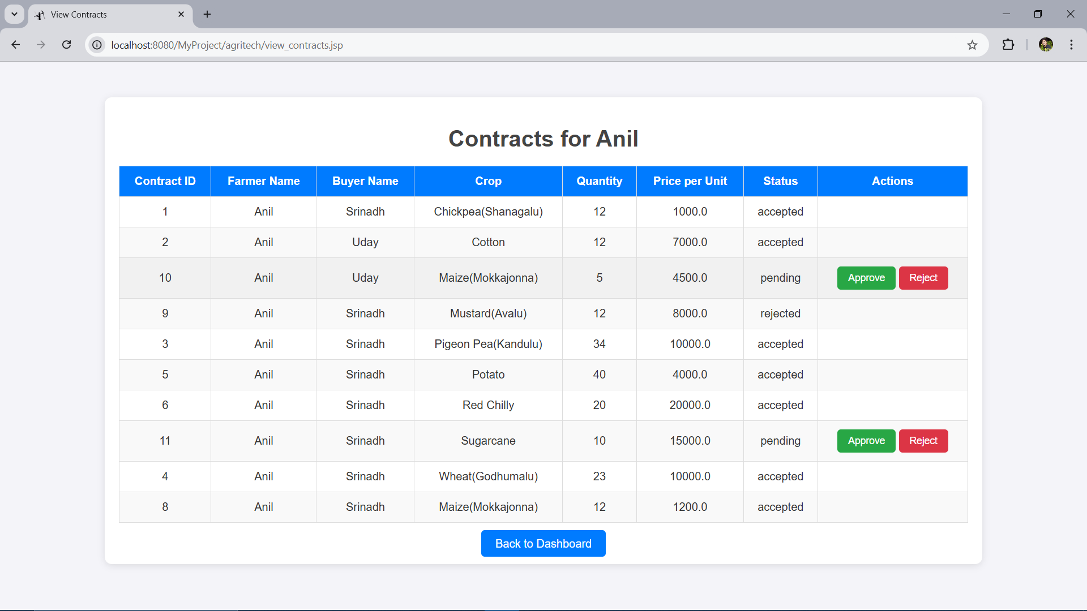
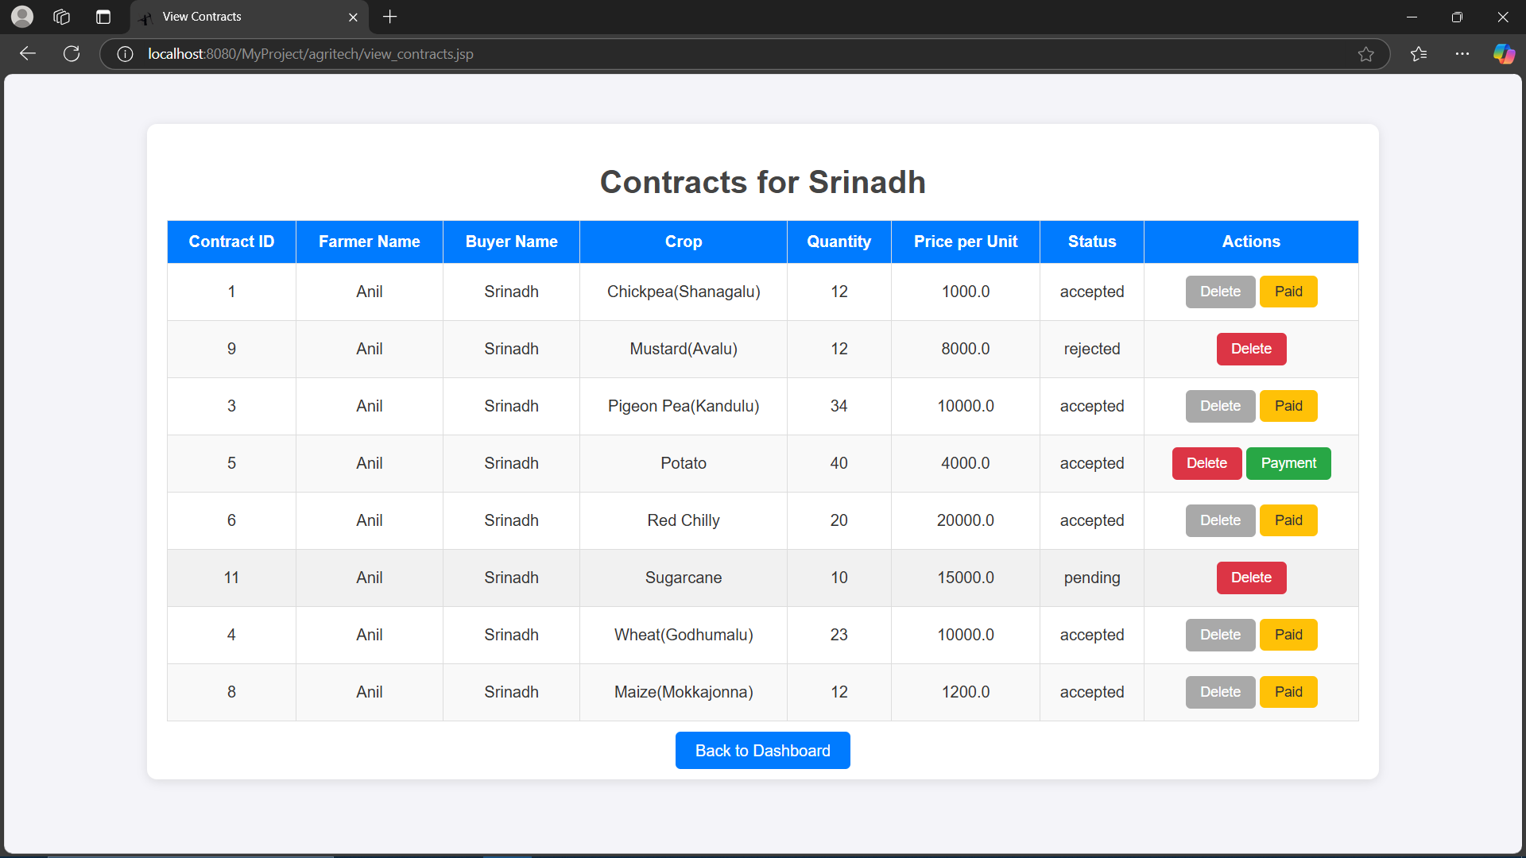
User Interface
Contracts table for Farmer’s and Buyer’s

Slide 13
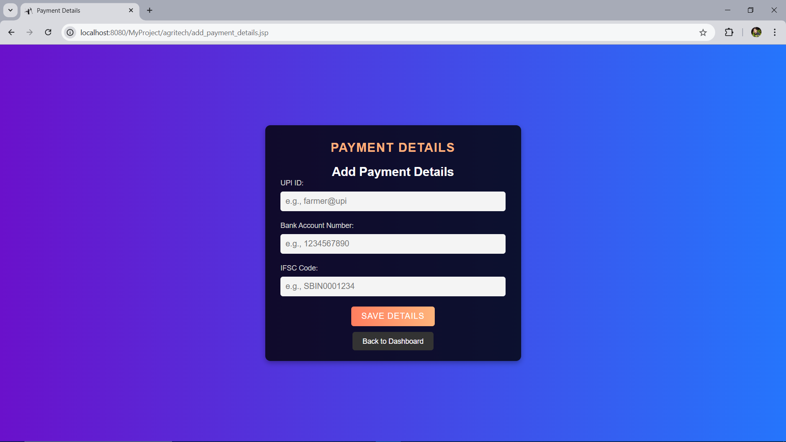
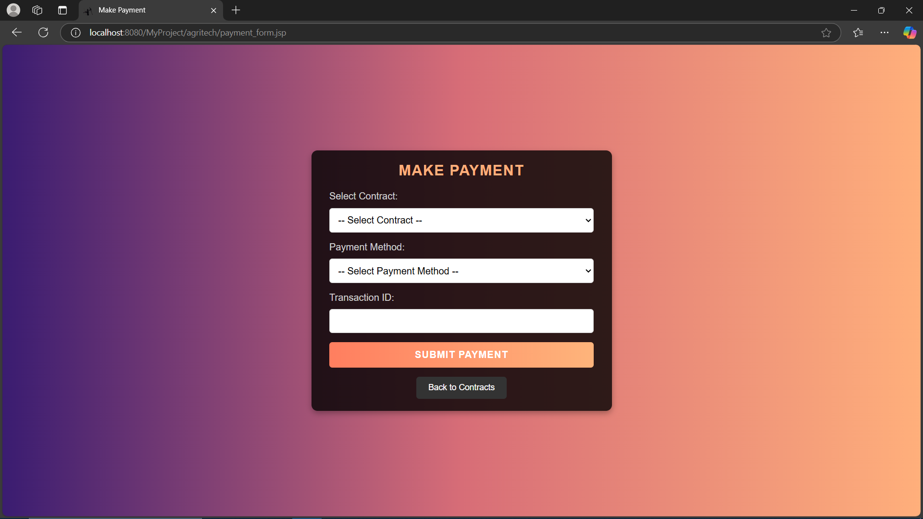
User Interface
Add Payment Details
Making Payments

Slide 14

Under the Guidance of
Mrs. Prathyusha mam
Presented By
Prashanth [B201068]
Srinadh [B200722]
Ramesh [B200571]

